Slide 1

WOMEN EMPOWERMENT

Slide 2


Slide 3

Empower women through education

Slide 4
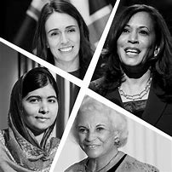
Empower women to be leaders

Slide 5

Promote gender equality

Slide 6

Support for Women empowerment

Slide 7

Benefits of empowering women:Positive mindset

Slide 8

Benefits of empowering women

Slide 9
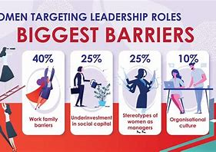
Challenges faced by women

